Slide 1
Class Diagrams

Slide 2
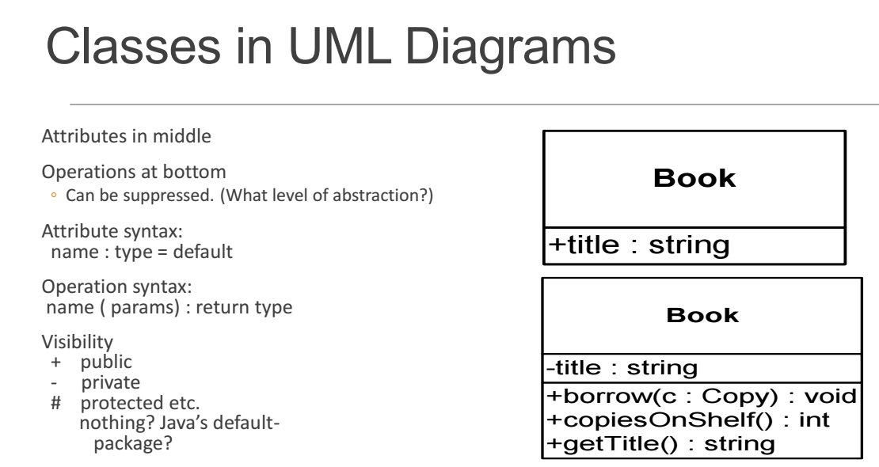

Slide 3
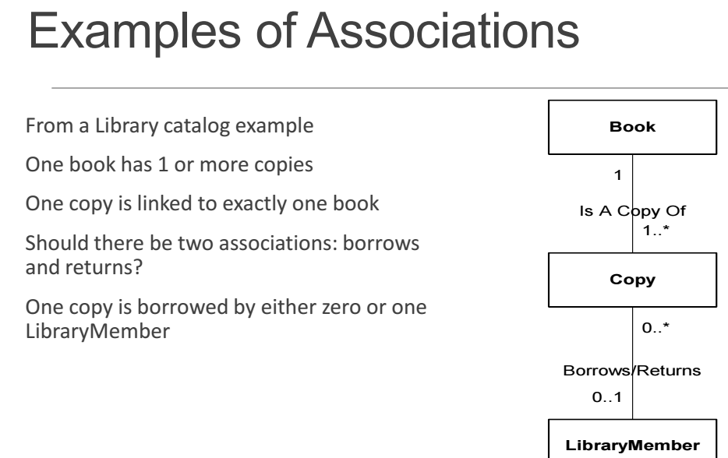

Slide 5
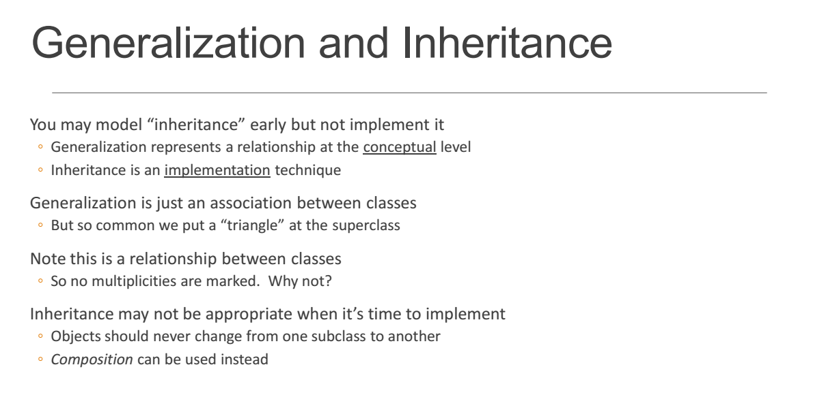

Slide 6
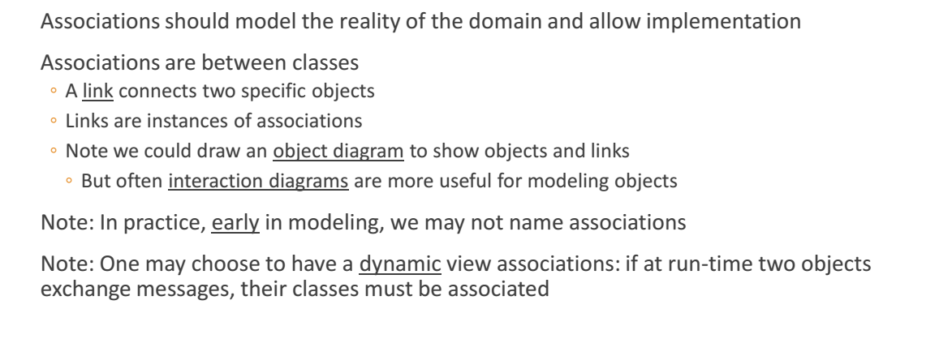

Slide 7
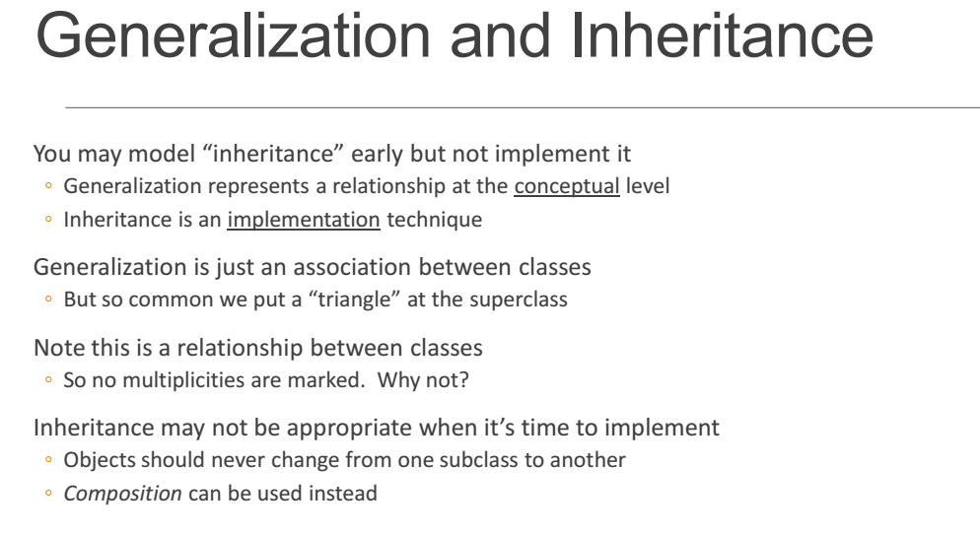

Slide 8
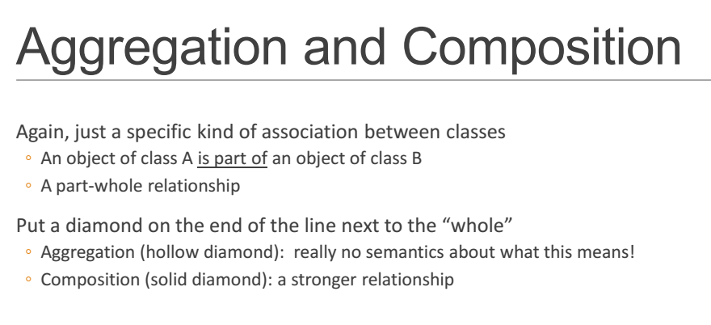

Slide 9
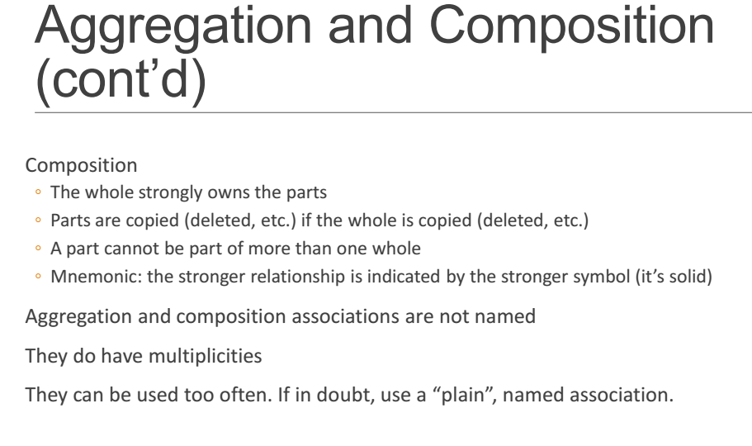

Slide 10
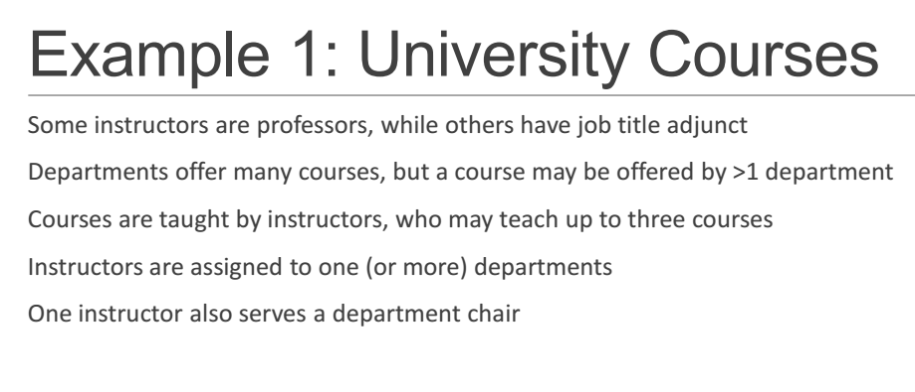

Slide 11
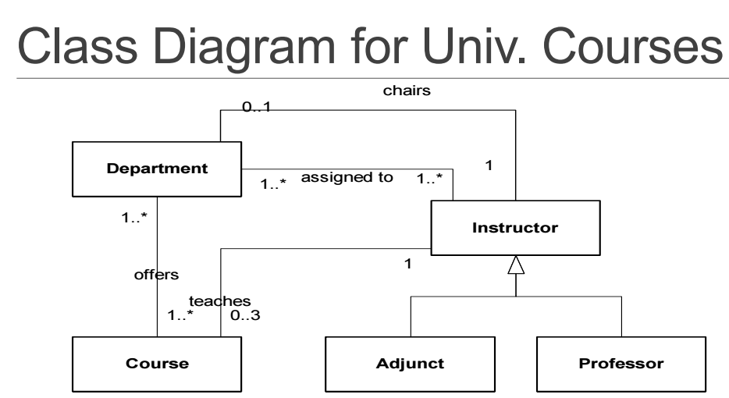

Slide 12
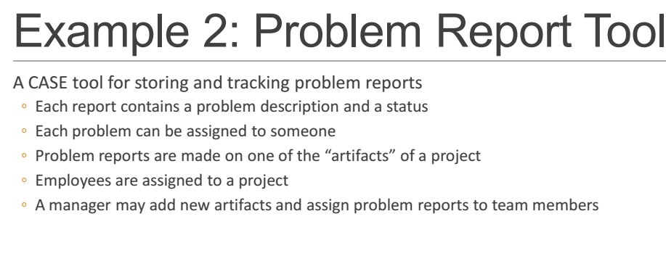

Slide 13
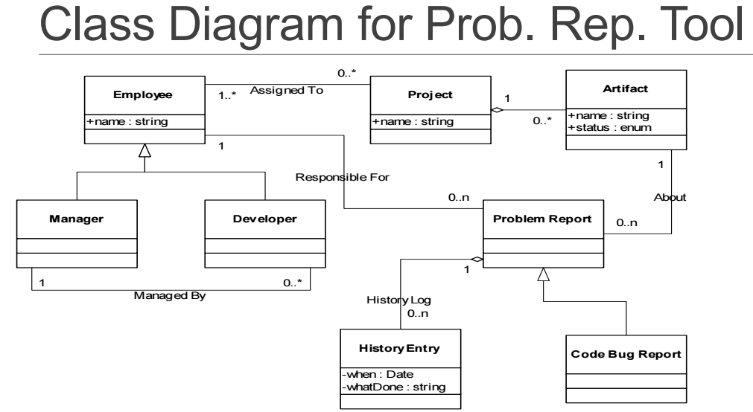

Slide 14
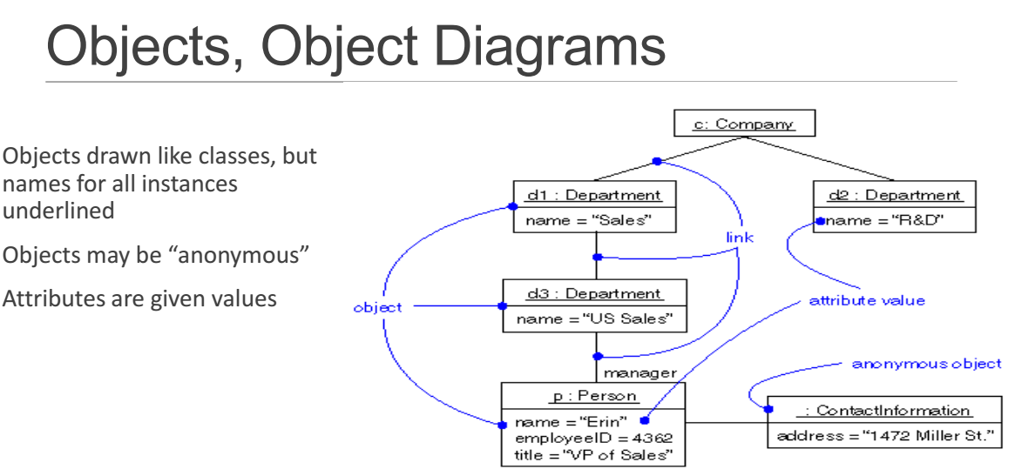

Slide 15
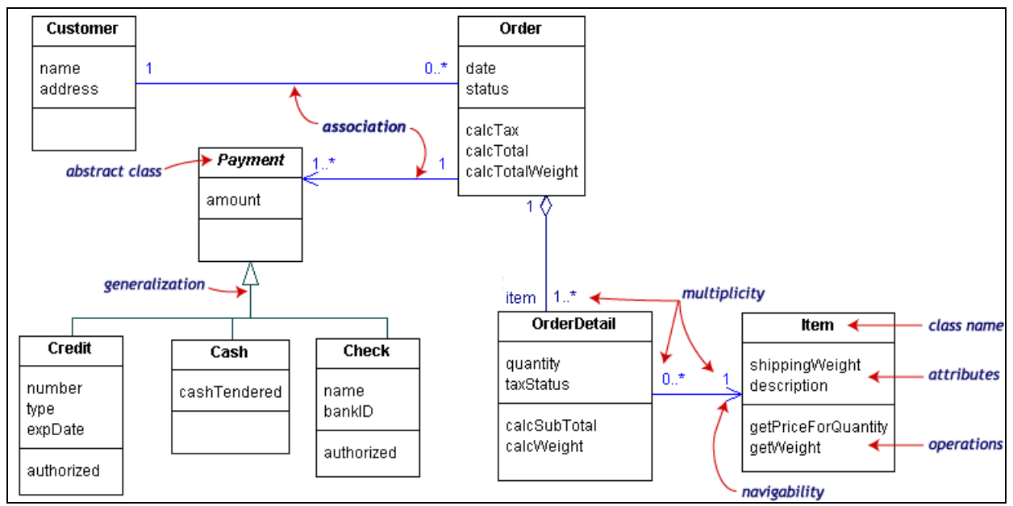

Slide 16
Modeling Classes
Given a real-life system, how do you decide what classes to use?
• What terms do the users and implementers use to describe the system? They are candidates for classes.
• Is each candidate class crisply defined?
• For each class, what is its set of responsibilities? Are the responsibilities evenly balanced among the classes?
• What attributes and operations does each class need to carry out its responsibilities?
Aim for high cohesion within classes and weak coupling
between them.

Slide 17
Noun Identification: A Library Example
The library contains books and journals. It may have several copies of a given book. Some of the books are reserved for short-term loans only. All others may be borrowed by any library member for three weeks. Members of the library can normally borrow up to six items at a time, but members of staff may borrow up to 12 items at one time. Only members of staff may borrow journals.
The system must keep track of when books and journals are borrowed and returned and enforce the rules.

Slide 18
Noun Identification: A Library Example
The library contains books and journals. It may have several copies of a given book. Some of the books are reserved for short-term loans only. All others may be borrowed by any library member for three weeks. Members of the library can normally borrow up to six items at a time, but members of staff may borrow up to 12 items at one time. Only members of staff may borrow journals.
The system must keep track of when books and journals are borrowed and returned and enforce the rules.

Slide 19
Candidate Classes
Library the name of the system
Book
Journal
Copy
ShortTermLoan event
LibraryMember
Week measure
MemberOfLibrary repeat
Item book or journal
Time abstract term
MemberOfStaff
System general term
Rule general term

Slide 20
Relations between Classes
Book is an Item
Journal is an Item
Copy is a copy of a Book
LibraryMember
Item
MemberOfStaff is a LibraryMember
Is Item needed?

Slide 21
Operations
LibraryMember borrows Copy
LibraryMember returns Copy
MemberOfStaff borrows Journal
MemberOfStaff returns Journal
Item not needed yet.

Slide 22
Class Diagram
MemberOfStaff
LibraryMember
1
1
on loan
on loan
0..*
0..12
Journal
Copy
is a copy of
1..* 1
Book

Slide 23
Rough Sketch: Wholesale System
A wholesale merchant supplies retail stores from stocks of goods in a warehouse.
What classes would you use to model this business?

Slide 24
Rough Sketch: Wholesale System
RetailStore
Order
Merchant
Product
Warehouse
Shipment
Invoice

Slide 25
Rough Sketch: Wholesale System
Merchant
RetailStore
name
address
contactInfo
financialInfo
Shipment
Responsibilities
-track status of shipped products
Warehouse
Order
Product
responsibility (text field)
Reversal
damaged()
return()
wrongItem()
Invoice

Slide 26
Expanding a Class: Modeling Financial Information
RetailStore
association
1 *
Transaction
Which class is responsible for the financial records for a store?
Payment
Invoice

Slide 27
Modeling Invoice
Shipment
???
RetailStore
invoiceRecord
goodsShipped
Invoice
invoiceNumber
+goodsShipped()
-sendInvoice()
PartsList
adornments
+ public
- private

Slide 28
Lessons Learned
Design is empirical. There is no single correct design. During the design process:
• Eliding: Elements are hidden to simplify the diagram
• Incomplete: Elements may be missing.
• Inconsistency: The model may not be consistent
The diagram is not the whole design. Diagrams must be backed up with specifications.

Slide 29
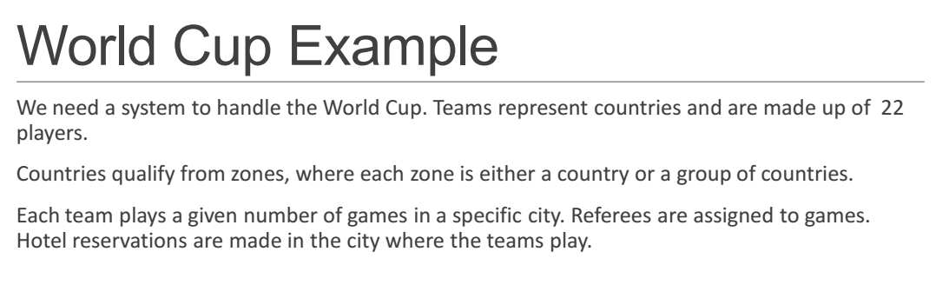

Slide 30
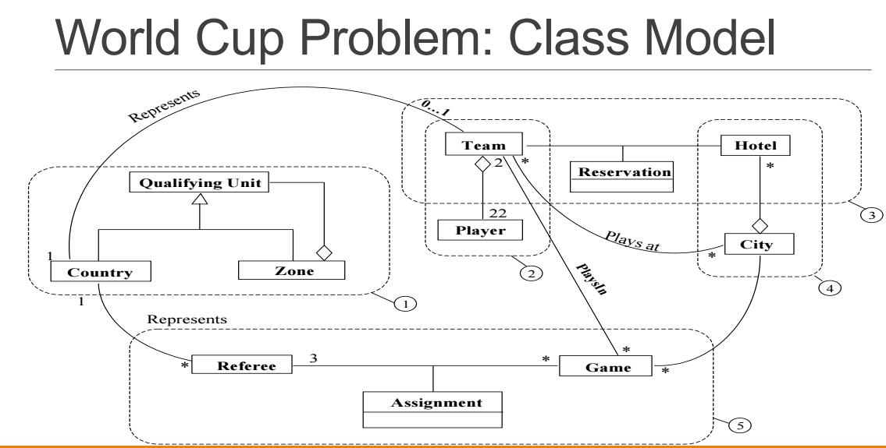

Slide 31
Example: Flow of events
The customer enters a store with the intention of buying a toy for his child with the age of n.
Help must be available within less than one minute.
The store owner gives advice to the customer. The advice depends on the age range of the child and the attributes of the toy.
The customer selects a dangerous toy which is kind of unsuitable for the child.
The store owner recommends a more yellow doll.

Slide 32



Mapping Parts of Speech to Object Model Components
Part of speech
Model component
Example
Proper noun
object
Jim Smith
Improper noun
class
Toy, doll
Doing verb
method
Buy, recommend
being verb
inheritance
is-a (kind-of)
having verb
aggregation
has an
modal verb
constraint
must be
adjective
attribute
3 years old
transitive verb
method
enter
intransitive verb
method (event)
depends on

Slide 33
Another Example
Flow of events:
The customer enters the store to buy a toy.
It has to be a toy that his daughter likes and it must cost less than 50 Euro.
He tries a videogame, which uses a data glove and a head-mounted display. He likes it.
Is this a good use
Case?
An assistant helps him.
The suitability of the game depends on the age of the child.
His daughter is only 3 years old.
The assistant recommends another type of toy, namely the boardgame “Monopoly".
Not quite!
“Monopoly” is probably a
left over from the scenario
The use case should
terminate with the
customer leaving the store

Slide 34
Textual Analysis Using Abbot‘s Technique
Example
Grammatical construct
UML Component
“Monopoly"
Concrete Person, Thing
Object
“toy"
noun
class
"3 years old"
Adjective
Attribute
“enters"
verb
Operation
“depends on…."
Intransitive verb
Operation (Event)
“is a" ,“either..or",
“kind of…"
Classifying verb
Inheritance
"Has a ", “consists of"
Possessive Verb
Aggregation
“must be", “less than…"
modal Verb
Constraint

Slide 35
Class Identification
Identify the boundaries of the system
Identify the important entities in the system
Class identification is crucial to object-oriented modeling
Basic assumption:
1. We can find the classes for a new software system (Forward Engineering)
2. We can identify the classes in an existing system (Reverse Engineering)

Slide 36
Generation of a class diagram from flow of events
Customer
Flow of events:
The customer enters the store to buy a toy. It has to be a toy that his daughter likes and it must cost less than 50 Euro. He tries a videogame, which uses a data glove and a head-mounted display. He likes it.
customer
enters
store
buy
?
enter()
daughter
store
enter()
less than 50 Euro
toy
videogame
daughter
daughter
age
suitable
An assistant helps him. The suitability of the game depends on the age of the child. His daughter is only 3 years old. The assistant recommends another type of toy, namely a boardgame. The customer buy the game and leaves the store
*
depends
toy
price
buy()
like()
toy
buy()
toy
age
boardgame
type of toy
boardgame
videogame

Slide 37
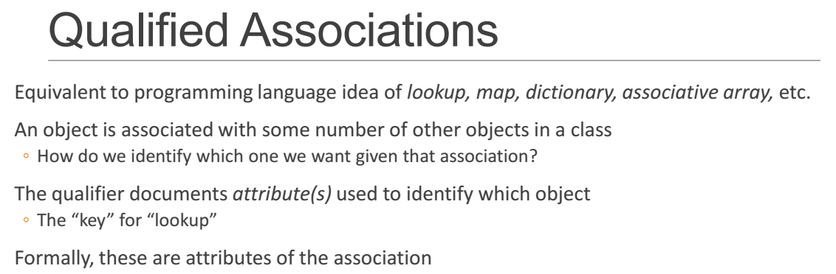

Slide 38
